Slide 1
WEB SCRAPING IMDb METHODOLOGY PRESENTATION
Team Members:
4NM20IS056-Hrithik
4NM20IS057-Jeevith
4NM20IS098-Pramith

Slide 2
ARCHITECTURE
Web Request: The first component of web scraping is to send a request to the IMDb website using requests library. This request will retrieve the HTML code of the website, which can be used to extract the desired information.
HTML Parser: Once the HTML code of the website has been retrieved, it needs to be parsed to extract relevant information. Beautiful Soup is a Python library that provides a convenient way to parse HTML code and extract information from it.
Data Extraction: With the help of Beautiful Soup, desired data (movie title, genre, ratings, etc) can be extracted from the HTML code by using its various methods like find, find_all, select, etc. These method locate the specific HTML tags that contain the data to be extracted.

Slide 3
ARCHITECTURE
Data Storage: After extracting the desired data, data storage options like excel and a database is used to store the extracted data.
Data Analysis: Once the data has been extracted, and stored, analysis can be performed on it using libraries like pandas and matplotlib.

Slide 4
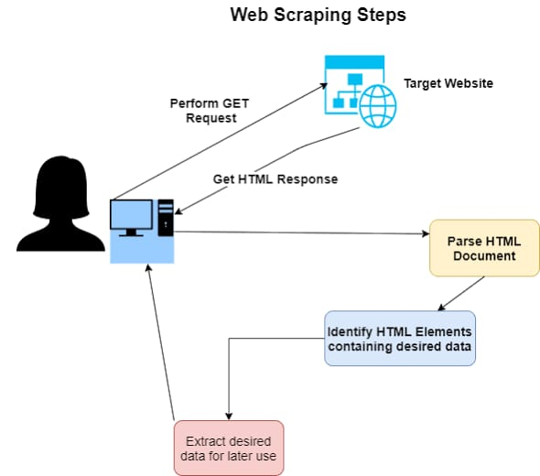
BLOCK DIAGRAM

Slide 5
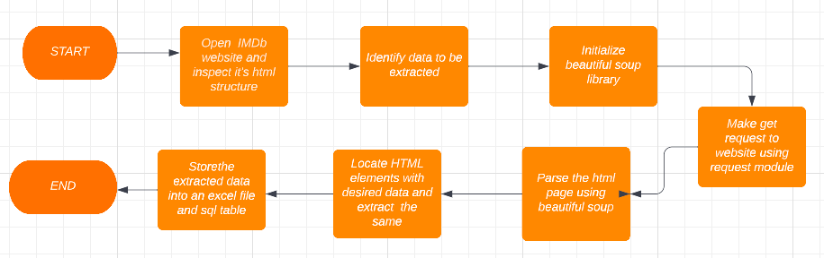
FLOW CHART

Slide 6
ALGORITHM
Step 1.Identify the web pages to scrape:
In this step, we need to determine which pages on the IMDB website you want to scrape
.
Step 2.Analyze the structure of the web pages: Once you've identified the web pages to scrape, you need to analyze their structure to determine where the data you want to extract is located. This involves looking at the HTML code of the web pages and identifying the tags, attributes, and classes that contain the data you need.
Step 3.Import necessary tools/modules: installed and initialize the necessary libraries and tools.such as Requests and BeautifulSoup.
Step 4.Send a request to the website: Before you can scrape data from a website, you need to send a request to the website to retrieve the web pages you want to scrape. This can be done using the Requests library in Python.

Slide 7
ALGORITHM
Step 5.Parse the HTML content: Once you've received the HTML content of the web pages, you need to parse it to extract the data you need. This can be done using the BeautifulSoup Library in Python.
Step 6.Extract the data: Using the information you gathered in step 2, you can extract the data you need from the parsed HTML content. This might involve finding specific tags, attributes, or classes that contain the data, or using regular expressions to extract patterns of text
.
Step 7.Store the data: Once you've extracted the data, you'll need to store it in a format that you can use later. This might involve writing the data to a CSV or Excel file, storing it in a database, or using it directly in your Python code.

